Slide 1



OELP Mid-Semester Presentation
Measuring Negative Inductance
Kevin R Jacob(122101018)
Manikantan R S(122101046)
Faculty advisor: Dr. Arvind Ajoy
Notes:
Hello and welcome to our midsem OELP presentation. Our OELP is about measuring negative inductance. This is a continuation of Priyankka’s work. Before we get to negative inductance, lets briefly discuss what inductance is.

Slide 2


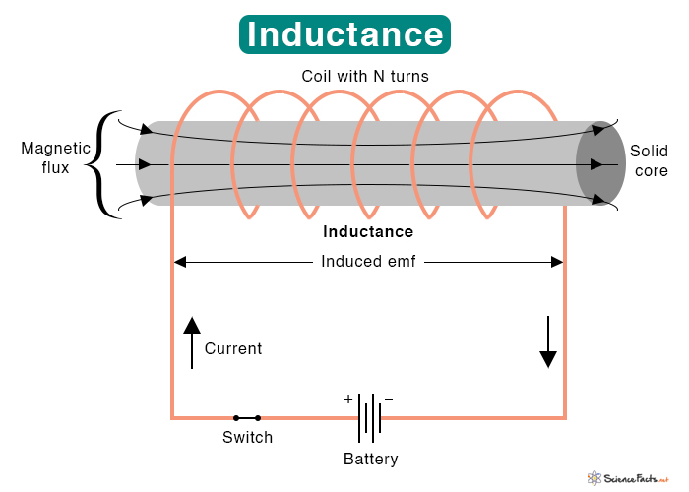
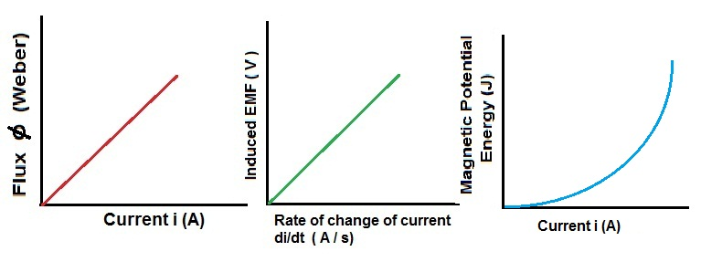
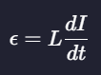
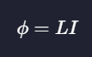
What is Inductance?
The tendency of a electrical conductor to oppose to change of current flowing through it.
Notes:
What is inductance? Inductance is the property of a material to oppose the change of current flowing through it.
We are all aware of faraday’s law that states that change in magnetic flux causes an emf that tries to undo the change in flux.
The flux is dependent on current, and hence a change in current causes the change in flux.
Inductance is the factor that determines the strength of the response of the material to a change in current.
Hence as the current increases the flux increases. The proportionality constant is inductance.

Slide 3
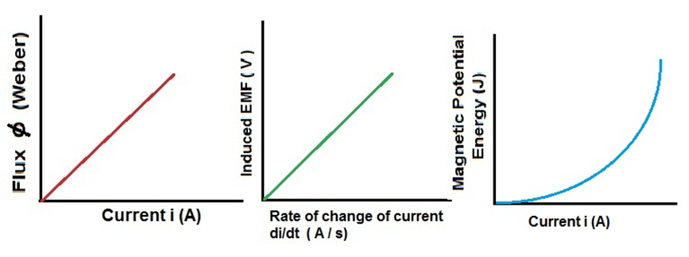
Negative Inductance
As magnetic flux increases, the current decreases.
Violates the conservation of energy.
Hence it is a transient phenomenon.
Notes:
Negative inductance is the opposite of positive inductance. Or instead of opposing the change in current it helps it. Clearly this phenomenon raises the question energy conservation. Hence forth this phenomenon is only observed in short periods of time. Some materials which have a positive inductance seem to show this transient phenomenon. Ferromagnetic materials are theorized to show this.
Lets see how such a phenomenon is possible.

Slide 4
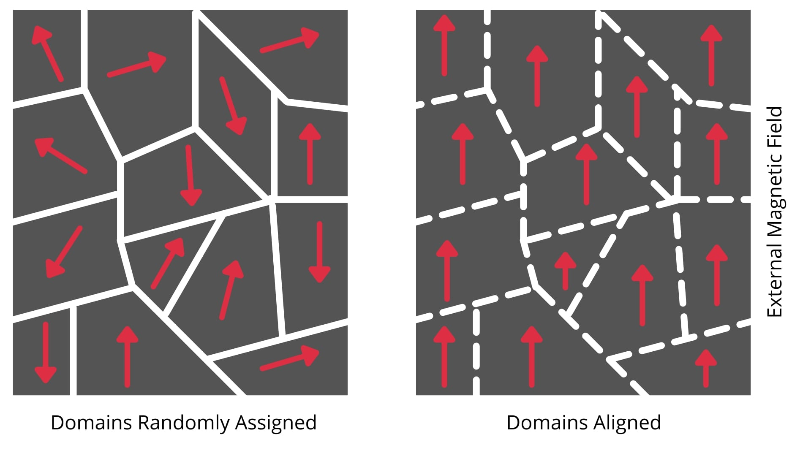
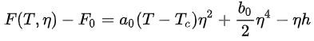
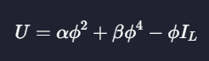
Ferromagnetism
Landau Theory of Ferromagnetism
Phase transition equations:
Notes:
Ferromagnetism is the property of materials to be strongly attracted to magnetic fields. It is much stronger than paramagnetism and is the polar opposite of diamagnetism.
In a ferromagnet, there are different regions of the same of magnetic orientations called domains. Each domain contains many molecules acting like a single entity. The magnetization and its characteristics can be modelled by landau theory. The general model is given here. And in the case of ferromagnetism, the order parameter yeta is the magnetic flux. And the external field applied is the current.

Slide 5
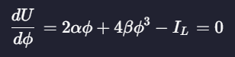
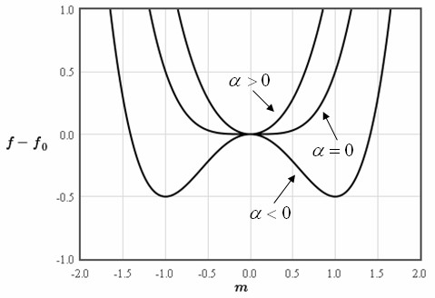
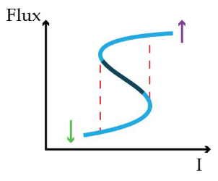
Ferromagnetism
Energy Double Well
S-curve
S curve plot taken from Priyankka’s BTP report
Notes:
Here the free energy function creates a double well structure, showing the two stable states. The current is the external field applied here.
By setting the derivative of the free energy wrt the order parameter to zero, A curve can be found relating the current flowing the inductor and its magnetic flux. This curve has a shave of an S. When plotted as a Phi versus I graph, the slope of the curve represents the inductance. Here we can see a region of negative slope. This region when there is transition from one stable state to the next, a negative inductance can be theoretically observed. This is the justification for negative inductance from the theory side.

Slide 6
Modelling Transient Negative Inductance
Landau based Model(Single Domain System)
Ising Based Model(Multidomain System)
Notes:
Two type of modelling strategies were used to understand Transient Negative Inductance. Let’s discuss the first approach. The Single domain system model.

Slide 7
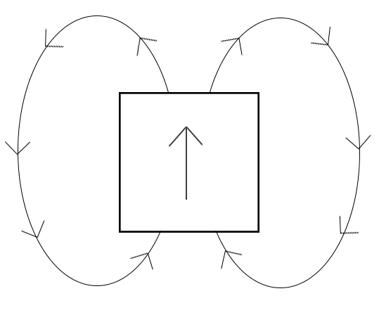
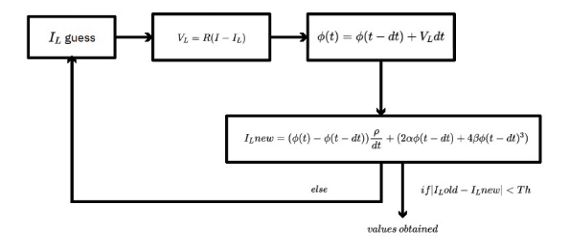
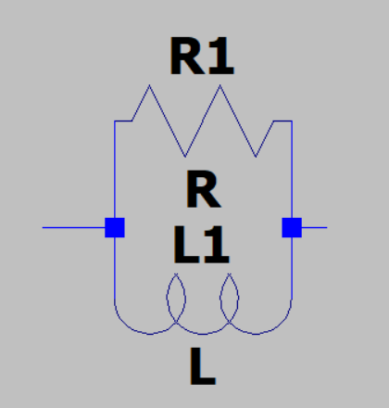
Landau Based Model
Bistable Single Domain System
Resistor and Inductor in parallel driven by a current source.
Simulation Algorithm:
Algorithm flowchart taken from Priyankka’s BTP report
Notes:
Algorithm is based on finding the current through the inductor, which was used to find flux, which in turn is used to find a new I_L. By iterating this set up till a constant I_L achieved gives, the response of the inductor, to an applied current.

Slide 8
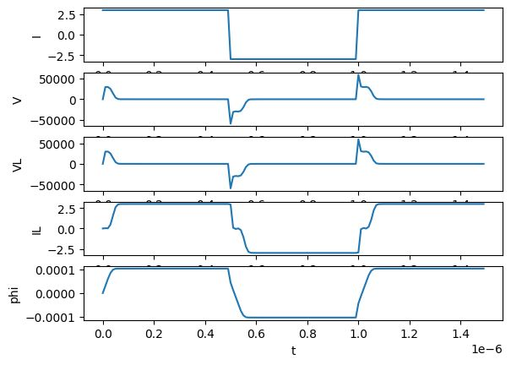
Landau Based Model
Plot of:
Input current
Voltage Across the resistor and inductor.
Inductor Current
Inductor flux
Notes:
The first plot is the input current and the second one is the voltage across the inductor and resistor. The inductor current is given in the third plot and fourth plot has the flux. In this region here one can observe a slight dip in current for increasing flux. This is the region of Negative inductance.

Slide 9
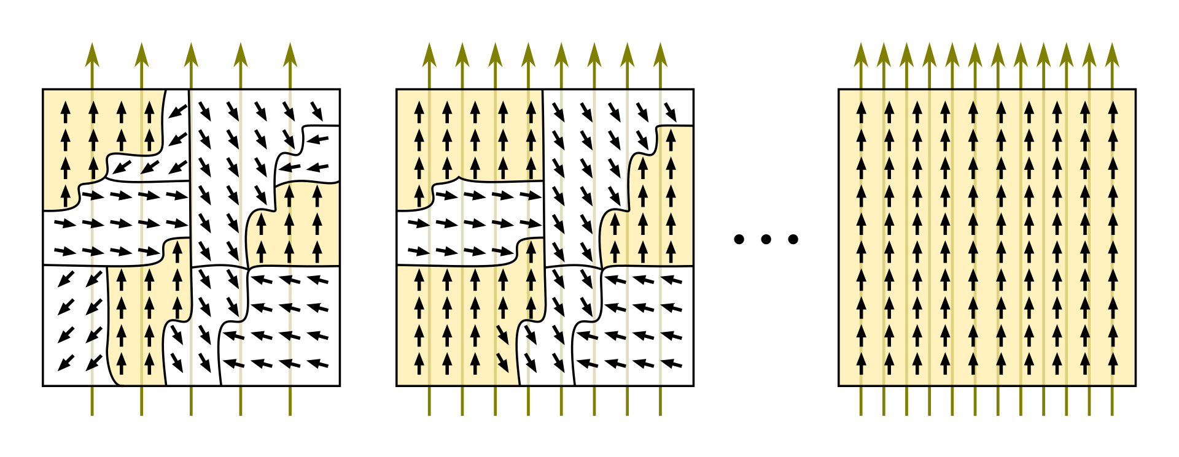
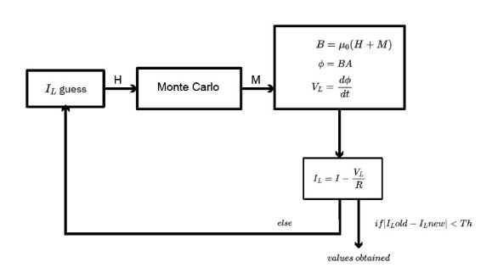
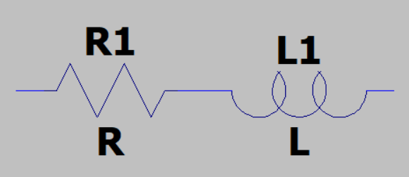
Ising Based Model
Multidomain System(Two states for each domain)
Simulation Algorithm:
Algorithm flowchart taken from Priyankka’s BTP report
Notes:
The ising model uses a similar approach of using the current to find the flux, to find a new I_L. And iterating this several times gives the response to a input current. Similar results are obtained from the Ising based model. The ising model is better model as no real system is a single domain ferromagnet.

Slide 10
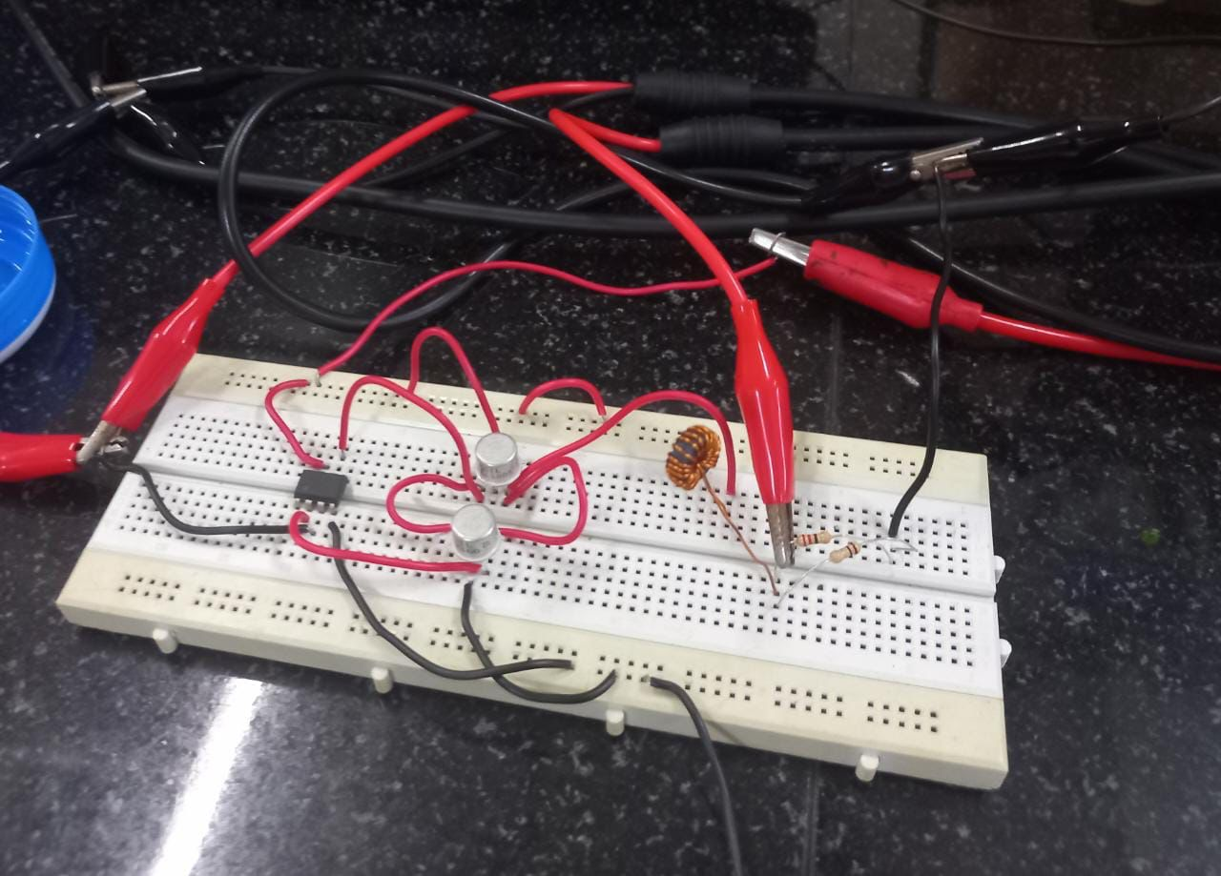
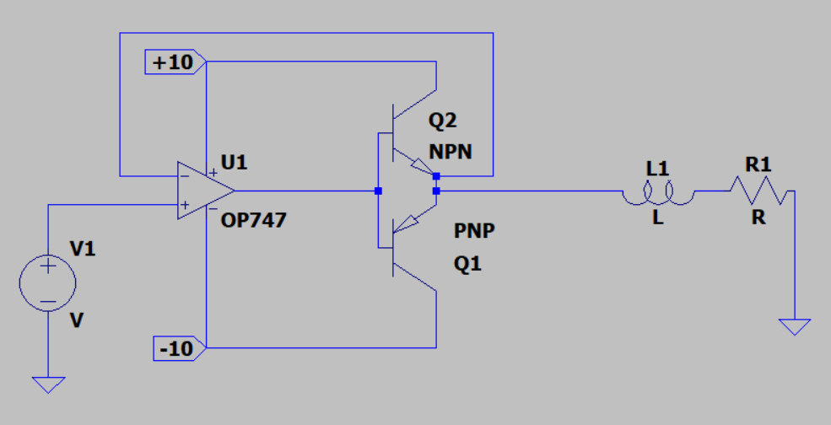
Hysteresis Measurement
Measurement and Plotting of B-H Characteristics.
Notes:
This is part of the experimental set up to measure the BH characteristics of the Ferrite Toroidal Core used. The circuit used is a simple circuit that boosts the current output of the power supply as about 50mA to 100mA of current is required. The first part is a voltage buffer and the transistors make up a push pull amplifier that removes crossover distortions. The inductor is attached with a resistor in series and grounded.

Slide 11
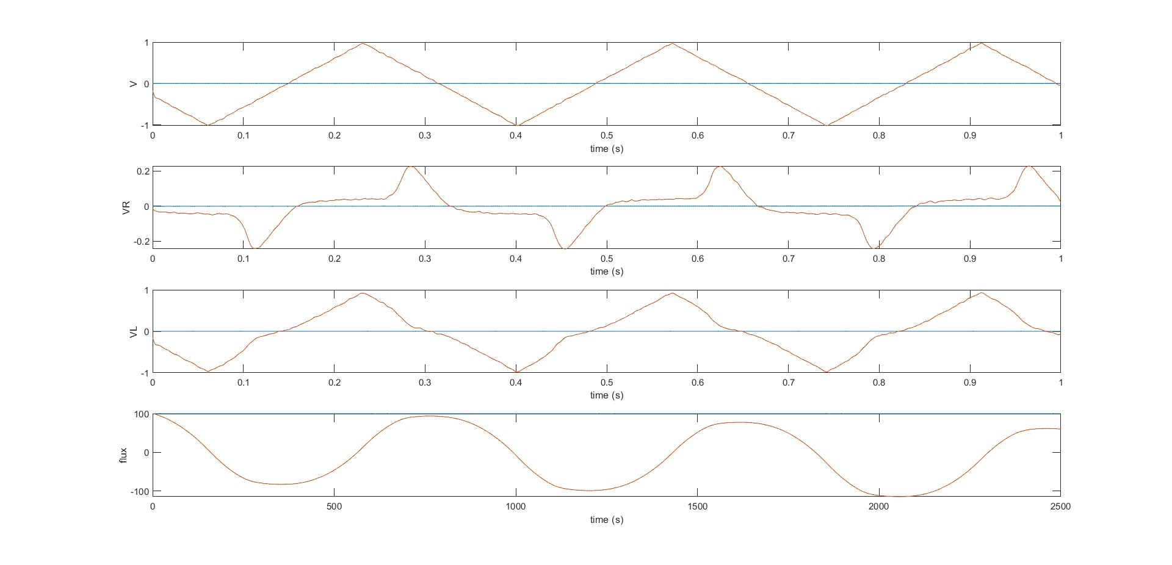
Measurement Results
Notes:
From the experiment, voltages at the ouput and across the resistor were read using a Digital Signal Oscilloscope and were processed on matlab. The current provided the applied magnetic field and the flux provided the magnetic field. Using this the B-H characteristics can be plotted.

Slide 12
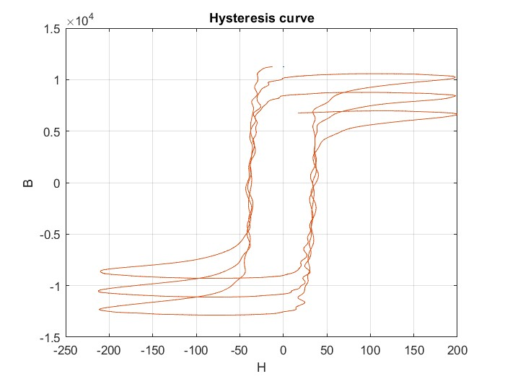
Measurement Results
Notes:
This is the BH characteristics curve received from plotting. This exercise lets us know how much current is required to saturate the core.

Slide 13
Next Work
Preparation for the measurement of Transient Negative Inductance.
Correlation of the experimental results with the simulation results.
Notes:
The practical measurement of the negative inductance has faced some problems as the available power supplies cannot supply enough current required to make the measurement. Hence a special power supply has to be assembled to do so. The components and design is ready, so once the set up is assembled, the measurement can be made.
Once the measurement is made, the experimental results and simulation results can be cross checked and verified.

Slide 14
References
Landau theory – Wikipedia

